Slide 1
Hash Tables
0
U
(universe of keys)
h(k₁)
h(k₄)
K
(actual
keys)
k₁
k₄
k₂
collision
h(k₂)=h(k₅)
k₅
k₃
h(k₃)
m–1

Slide 2
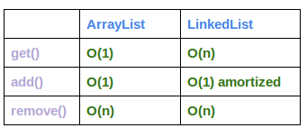

Slide 3
Dictionary
Dictionary:
Dynamic-set data structure for storing items indexed using keys.
Supports operations Insert, Search, and Delete.
Applications:
Symbol table of a compiler.
Memory-management tables in operating systems.
Large-scale distributed systems.
Hash Tables:
Effective way of implementing dictionaries.
Generalization of ordinary arrays.

Slide 4
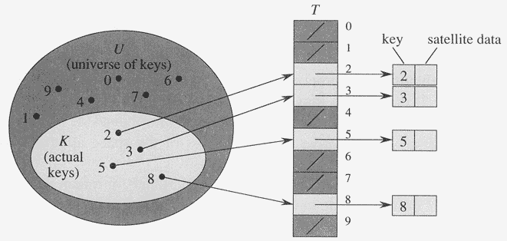
Direct-Address Tables
Direct-address Tables are ordinary arrays
Facilitate direct addressing
Element whose key is k is obtained by indexing into the k^{th} position of the array
Applicable when we can afford to allocate an array with one position for every possible key
i.e. when the universe of keys U is small
Dictionary operations can be implemented to take O(1) time

Slide 5
Direct-Address Tables
Suppose:
The range of keys is 0..m-1
Keys are distinct
The idea:
Set up an array T[0..m-1] in which
T[i] = x if x∈ T and key[x] = i
T[i] = NULL otherwise
This is called a direct-address table
Operations take O(1) time !
So what’s the problem?

Slide 6
Direct-Address Tables
Direct addressing works well when the range m of keys is relatively small
But what if the keys are 32-bit integers?
Problem 1: direct-address table will have 2³² entries, more than 4 billion
Problem 2: even if memory is not an issue, the time to initialize the elements to NULL may be
Solution: map keys to smaller range 0..m-1
This mapping is called a hash function

Slide 7
Hash Tables
Motivation: symbol tables
A compiler uses a symbol table to relate symbols to associated data
Symbols: variable names, procedure names, etc.
Associated data: memory location, call graph, etc.
For a symbol table (also called a dictionary), we care about search, insertion, and deletion
We want these to be fast, but don’t care about sorted order
The structure we will use is a hash table
Supports all the above in O(1) expected time !

Slide 8
Hash Tables
Notation:
U : Universe of all possible keys.
K : Set of keys actually stored in the dictionary.
|K| = n.
When U is very large,
Arrays are not practical.
|K| << |U|.
Use a table of size proportional to |K| – The hash tables.
However, we lose the direct-addressing ability.
Define functions that map keys to slots of the hash table.

Slide 10
Hashing
Hash function h: Mapping from U to the slots of a hash table T[0..m–1].
h : U → {0,1,…, m–1}
With arrays, key k maps to slot A[k].
With hash tables, key k maps or “hashes” to slot T[h[k]].
h[k] is the hash value of key k.

Slide 11
Hashing
0
U
(universe of keys)
h(k₁)
h(k₄)
K
(actual
keys)
k₁
k₄
k₂
collision
h(k₂)=h(k₅)
k₅
k₃
h(k₃)
m–1

Slide 12
Issues with Hashing
Multiple keys can hash to the same slot – collisions are possible.
Design hash functions such that collisions are minimized.
But avoiding collisions is impossible.
Design collision-resolution techniques.
Search will cost Ө(n) time in the worst case.
However, all operations can be made to have an expected complexity of Ө(1).

Slide 13
Methods of Resolution
Chaining:
Store all elements that hash to the same slot in a linked list.
Store a pointer to the head of the linked list in the hash table slot.
Open Addressing:
All elements are stored in hash table itself.
When collisions occur, use a systematic (consistent) procedure to store elements in free slots of the table.
0
k₁
k₄
k₅
k₂
k₆
k₇
k₃
k₈
m–1

Slide 14
Collision Resolution by Chaining
0
U
(universe of keys)
h(k₁)=h(k₄)
X
k₁
k₄
K
(actual
keys)
k₂
k₆
X
h(k₂)=h(k₅)=h(k₆)
k₅
k₈
k₇
k₃
X
h(k₃)=h(k₇)
h(k₈)
m–1

Slide 15
Collision Resolution by Chaining
Chaining puts elements that hash to the same slot in a linked list:
0
U
(universe of keys)
k₁
k₄
k₁
k₄
K
(actual
keys)
k₂
k₆
k₅
k₂
k₆
k₅
k₈
k₇
k₃
k₇
k₃
k₈
m–1

Slide 16
Chaining
T
U (universe of keys)
——
k₁
k₄
——
——
k₁
——
K (actual keys)
k₄
k₅
——
k₇
k₅
k₂
k₇
——
——
k₂
k₃
k₃
——
k₈
k₆
k₈
k₆
——
——
How do we insert an element?

Slide 17
Chaining
T
U (universe of keys)
——
k₁
k₄
——
——
k₁
——
K (actual keys)
k₄
k₅
——
k₇
k₅
k₂
k₇
——
——
k₂
k₃
k₃
——
k₈
k₆
k₈
k₆
——
——
How do we delete an element?

Slide 18
Chaining
T
U (universe of keys)
——
k₁
k₄
——
——
k₁
——
K (actual keys)
k₄
k₅
——
k₇
k₅
k₂
k₇
——
——
k₂
k₃
k₃
——
k₈
k₆
k₈
k₆
——
——
How do we search for a element with a given key?

Slide 19

Chaining Example
$h\left(k\right)=2k\%5$
keys:
2, 15, 23, 40, 62, 75

Slide 20

$h\left(k\right)=2k\%5$
keys:
20, 15, 40, 50, 75

Slide 21
Analysis of Chaining
Assume simple uniform hashing: each key in table is equally likely to be hashed to any slot
Given n keys and m slots in the table: the load factor α = n/m = average # keys per slot
What will be the average cost of an unsuccessful search for a key?

Slide 22
Analysis of Chaining
Assume simple uniform hashing: each key in table is equally likely to be hashed to any slot
Given n keys and m slots in the table, the load factor α = n/m = average # keys per slot
What will be the average cost of an unsuccessful search for a key? A: O(1+α)

Slide 23
Analysis of Chaining
Assume simple uniform hashing: each key in table is equally likely to be hashed to any slot
Given n keys and m slots in the table, the load factor α = n/m = average # keys per slot
What will be the average cost of an unsuccessful search for a key? A: O(1+α)
What will be the average cost of a successful search?

Slide 24
Analysis of Chaining
Assume simple uniform hashing: each key in table is equally likely to be hashed to any slot
Given n keys and m slots in the table, the load factor α = n/m = average # keys per slot
What will be the average cost of an unsuccessful search for a key? A: O(1+α)
What will be the average cost of a successful search? A: O(1 + α/2) = O(1 + α)

Slide 25
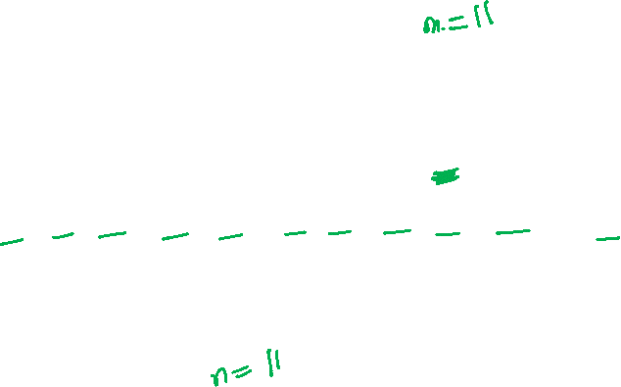
Analysis of Chaining
Draw the 11-item hash table that results from using
the hash function h(k) = (2k + 5) mod 11, to hash
the keys 12, 44, 13, 88, 23, 94, 11, 39, 20, 16, and 5,
assuming collisions are handled by chaining.

Slide 26
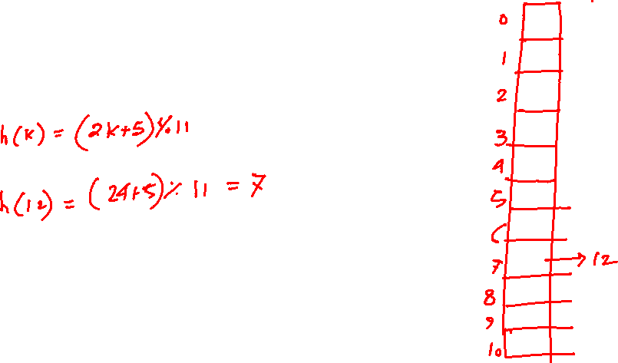
Analysis of Chaining
Draw the 11-item hash table that results from using
the hash function h(k) = (2k + 5) mod 11, to hash
the keys 12, 44, 13, 88, 23, 94, 11, 39, 20, 16, and 5,
assuming collisions are handled by chaining.

Slide 27
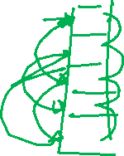
Open Addressing
Basic idea:
To insert: if slot is full, try another slot, …, until an open slot is found (probing)
To search, follow same sequence of probes as would be used when inserting the element
If reach element with correct key, return it
If reach a NULL pointer, element is not in table
Good for fixed sets (adding but no deletion)
Example: spell checking
Table needn’t be much bigger than n

Slide 28
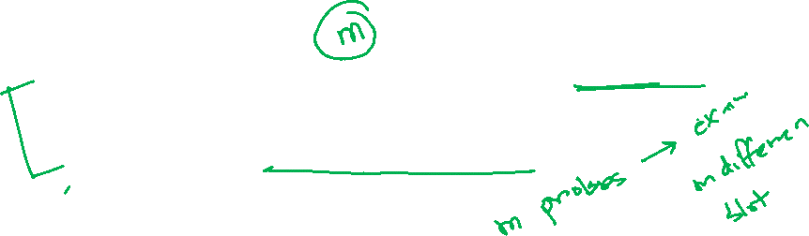
Probe Sequence
Sequence of slots examined during a key search constitutes a probe sequence.
Probe sequence must be a permutation of the slot numbers.
We examine every slot in the table, if we have to.
We don’t examine any slot more than once.
The hash function is extended to:
h : U × {0, 1, …, m – 1} → {0, 1, …, m – 1}
probe number slot number
⟨h(k, 0), h(k, 1),…,h(k, m – 1)⟩ should be a permutation of ⟨0, 1,…, m – 1 ⟩.

Slide 29
Computing Probe Sequences
The ideal situation is uniform hashing:
Generalization of simple uniform hashing.
Each key is equally likely to have any of the m! permutations of ⟨0, 1,…, m – 1⟩ as its probe sequence.
It is hard to implement true uniform hashing.
Approximate with techniques that at least guarantee that the probe sequence is a permutation of ⟨0, 1,…, m – 1⟩.
Some techniques:
Use auxiliary hash functions.
Linear Probing.
Quadratic Probing.
Double Hashing.
Can’t produce all m! probe sequences.

Slide 30
Linear Probing
h(k, i) = (h′(k) + i) mod m.
The initial probe determines the entire probe sequence.
T[h′(k)], T[h′(k)+1], …, T[m–1], T[0], T[1], …, T[h′(k)–1]
Hence, only m distinct probe sequences are possible.
Suffers from primary clustering:
Long runs of occupied sequences build up.
Long runs tend to get longer, since an empty slot preceded by i full slots gets filled next with probability (i+1)/m.
Hence, average search and insertion times increase.
key
Probe number
Auxiliary hash function

Slide 31
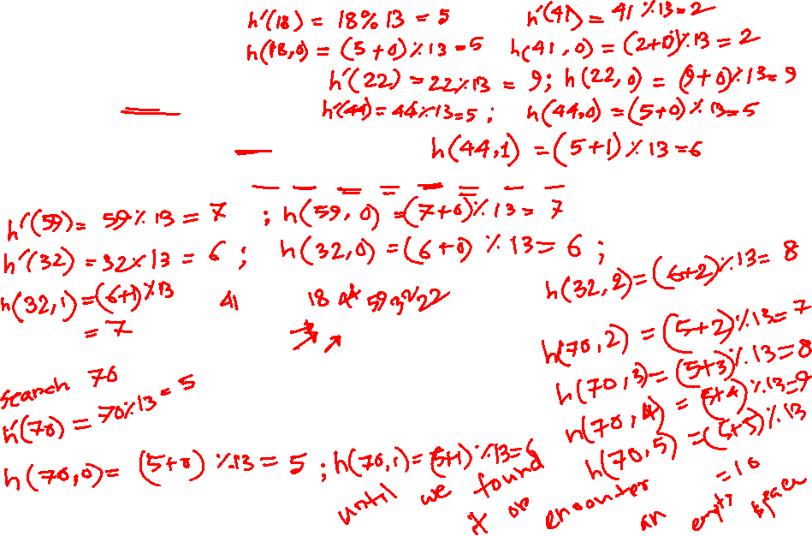
Ex: Linear Probing
Example:
h'(k) = k mod 13
h(k, i) = (h'(k) + i) mod 13
Insert keys 18, 41, 22, 44, 59, 32, 31, 73, in this order
0
1
2
3
4
5
6
7
8
9
10
11
12
41
18
44
59
32
22
31
73
0
1
2
3
4
5
6
7
8
9
10
11
12

Slide 32
Operation Insert
Act as though we were searching, and insert at the first NIL slot found.
Hash-Insert(T, k)
1. i ← 0
2. repeat j ← h(k, i)
3. if T[j] = NIL
4. then T[j] ← k
5. return j
6. else i ← i + 1
7. until i = m
8. error “hash table overflow”

Slide 33

Pseudo-code for Search
Hash-Search (T, k)
1. i ← 0
2. repeat j ← h(k, i)
3. if T[j] = k
4. then return j
5. i ← i + 1
6. until T[j] = NIL or i = m
7. return NIL

Slide 34
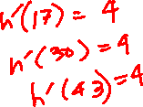
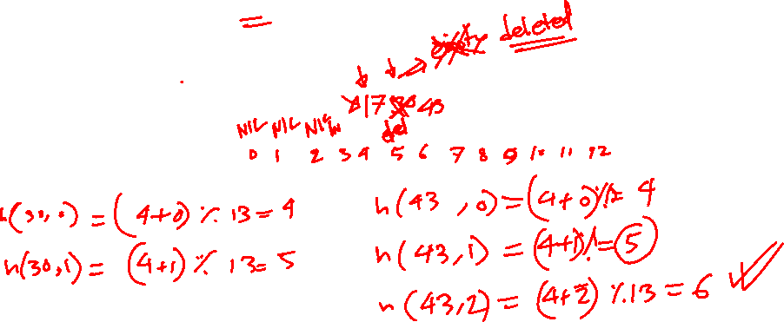
Example:
h'(k) = k mod 13
h(k, i) = (h'(k) + i) mod 13
Insert keys 17,30,43 in this order; delete 30; search 43;

Slide 35
Deletion
Cannot just turn the slot containing the key we want to delete to contain NIL. Why?
Use a special value DELETED instead of NIL when marking a slot as empty during deletion.
Search should treat DELETED as though the slot holds a key that does not match the one being searched for.
Insert should treat DELETED as though the slot were empty, so that it can be reused.
Disadvantage: Search time is no longer dependent on α.
Hence, chaining is more common when keys have to be deleted.
Notes:
Deletion from an open-address hash table is difficult. When we delete a key from slot i, we cannot simply mark that slot as empty by storing NIL in it. Doing so might make it impossible to retrieve any key k during whose insertion we had probed slot i and found it occupied.

Slide 36
Quadratic Probing
h(k, i) = (h′(k) + c₁i + c₂i²) mod m c₁≠ c₂
The initial probe position is T[h′(k)], later probe positions are offset by amounts that depend on a quadratic function of the probe number i.
Must constrain c₁, c₂, and m to ensure that we get a full permutation of ⟨0, 1,…, m – 1⟩.
Can suffer from secondary clustering:
If two keys have the same initial probe position, then their probe sequences are the same.
key
Probe number
Auxiliary hash function

Slide 37
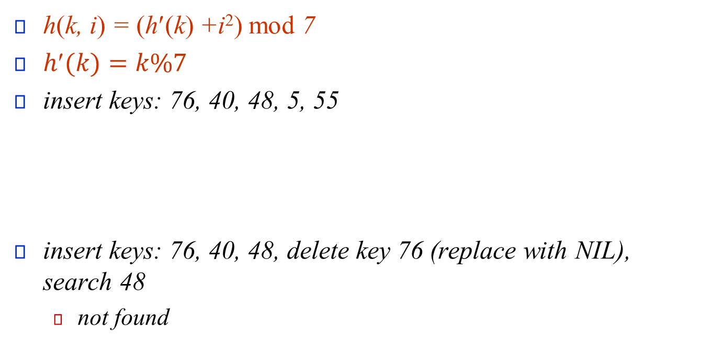
h(k, i) = (h′(k) +i²) mod 7
$h(k)=k\%7$
insert keys: 76, 40, 48, 5, 55
insert keys: 76, 40, 48, delete key 76 (replace with NIL), search 48
not found
0 | 1 | 2 | 3 | 4 | 5 | 6
48 |  | 5 | 55 |  | 40 | 76
0 | 1 | 2 | 3 | 4 | 5 | 6
48 |  |  |  |  | 40 | 76NIL

Slide 38
Double Hashing
h(k,i) = (h₁(k) + i h₂(k)) mod m
Two auxiliary hash functions.
h₁ gives the initial probe. h₂ gives the remaining probes.
Must have h₂(k) relatively prime to m, so that the probe sequence is a full permutation of ⟨0, 1,…, m – 1⟩.
Choose m to be a power of 2 and have h₂(k) always return an odd number. Or,
Let m be prime, and have 1 < h₂(k) < m.
Θ(m²) different probe sequences.
One for each possible combination of h₁(k) and h₂(k).
Close to the ideal uniform hashing.
key
Probe number
Auxiliary hash functions

Slide 39
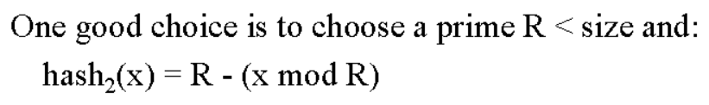

h(k,i) = (h₁(k) + i h₂(k)) mod 7
$h_{1}\left(k\right)=k\%7,$
$h_{2}\left(k\right)=5−(k\%5)$
keys: 76, 40, 47, 55, 10, 93,
0 | 1 | 2 | 3 | 4 | 5 | 6
 | 47 | 93 | 10 | 55 | 40 | 76

Slide 40
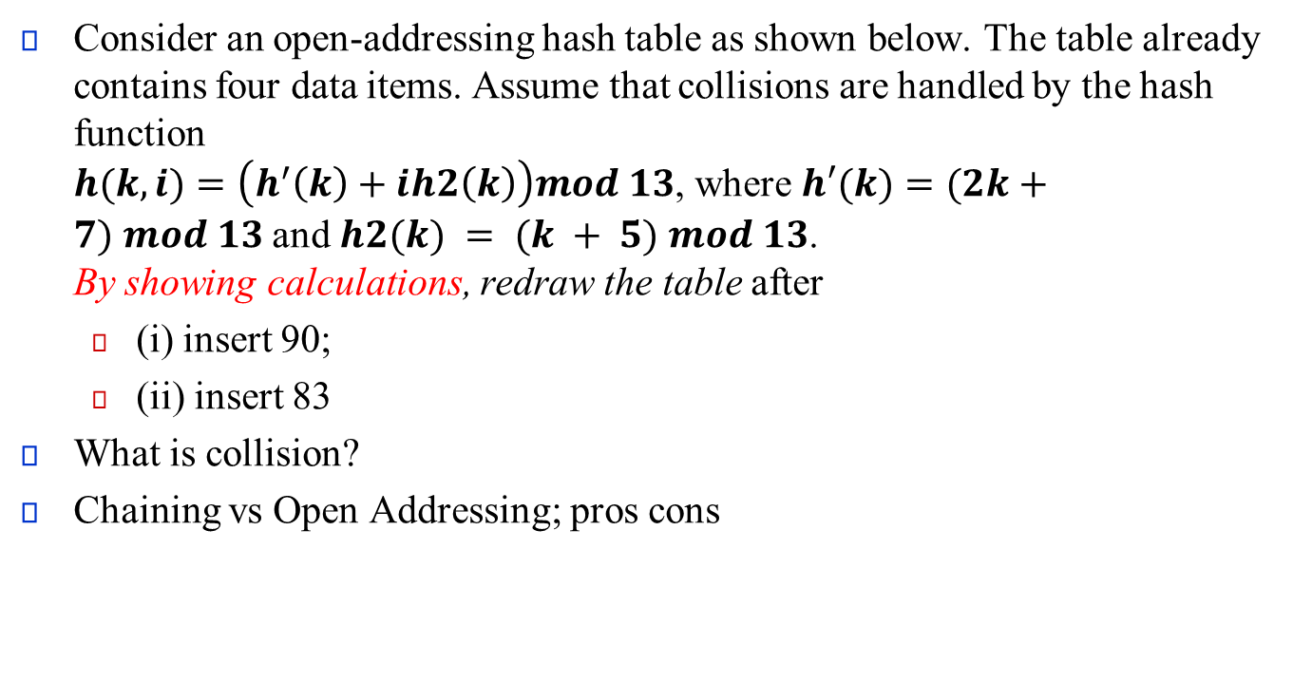
Consider an open-addressing hash table as shown below. The table already contains four data items. Assume that collisions are handled by the hash function $h(k, i)=\left(h^{′}\left(k\right)+ih2\left(k\right)\right)mod 13$, where $h′(k)=(2k+7) mod 13$and $h2(k) = (k + 5) mod 13$. By showing calculations, redraw the table after
(i) insert 90;
(ii) insert 83
What is collision?
Chaining vs Open Addressing; pros cons

